Slide 1

Sentiment Classification and Opinion Mining on Airlines Reviews

Slide 2
List of Contents
Aim Of The Project
Block diagram
Methodology
Flow chart
Algorithms
Applications
Output
Conclusion

Slide 3

Aim of The Project
The main aim of sentiment classification is to analyze an online document such as a blog, comment, review and new items as a comprehensive statements and categories it as positive, negative and neutral.

Slide 4
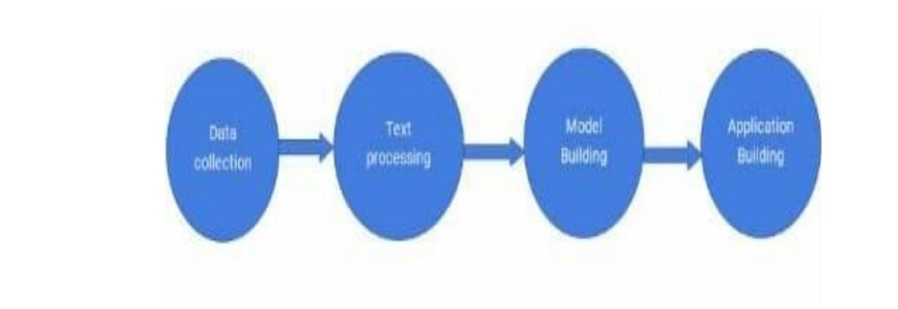
Block Diagram

Slide 5
Methodology
Data collection
Download dataset
Data preprocessing
Reading data
Data analysis
Data cleaning

Slide 6
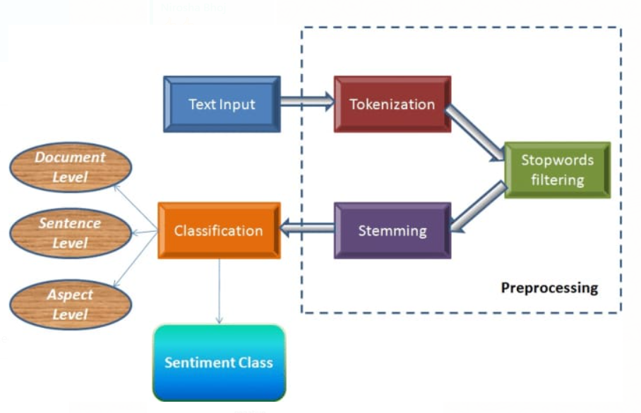
Methodology continuation...
Model building
1.split the data into
train and test
2.apply algorithm
3.save the model
Application Building
1.create html page
2.build python code

Slide 7
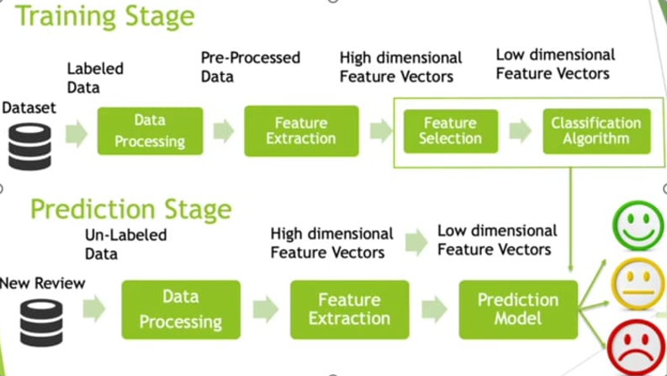
Methodology continuation...

Slide 8
Flow Chart
Start
Enter Twitter Search
Enter Data from twitter
Process tweet
Extract features
Training data
Algorithm
Connect to HTML page
Display Result
End

Slide 9
Algorithms

Slide 10
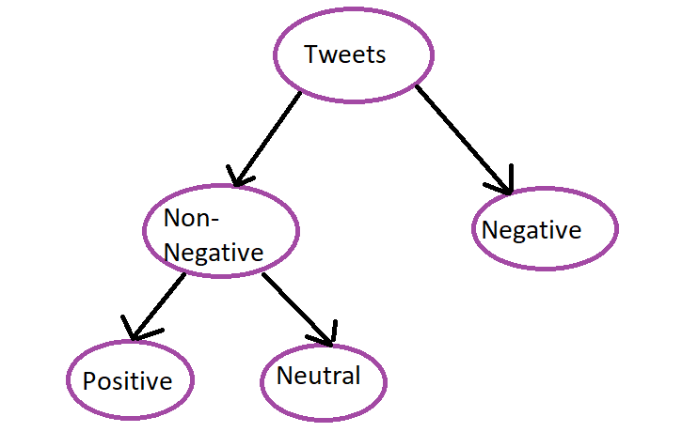
Decision Tree
Decision tree algorithm belongs to the family of supervised learning algorithms.
The goal of using a Decision tree is to create a training model that can be used to predict the class or value of the target variable by learning simple decision rules inferred from prior data(training data).

Slide 11
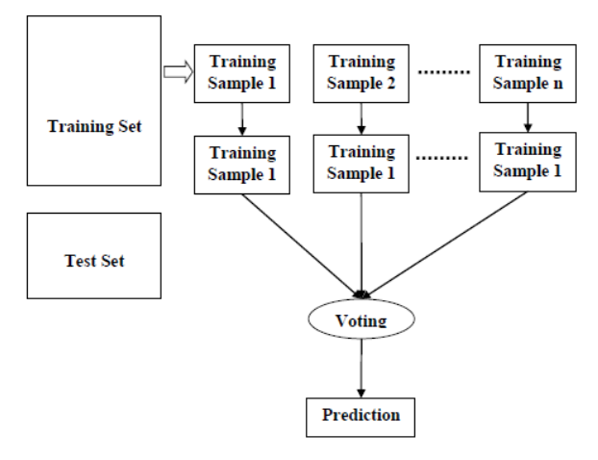
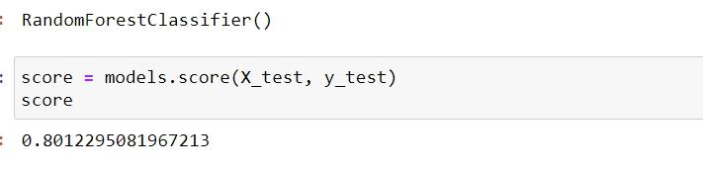
Random Forest
Random forest algorithm is a supervised learning algorithms which is used for both classification and regression
Accuracy:

Slide 12
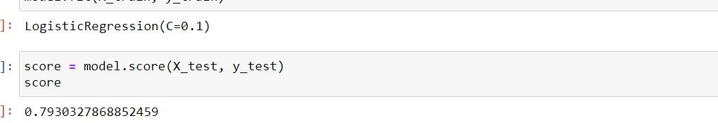
Logistic Regression
Logistic regression is a supervised learning algorithms which is used to predict the probability of target variable
It is one of the simplest ML algorithms that can e used for various classification problems such as spam detection,cancer detection etc.

Slide 13
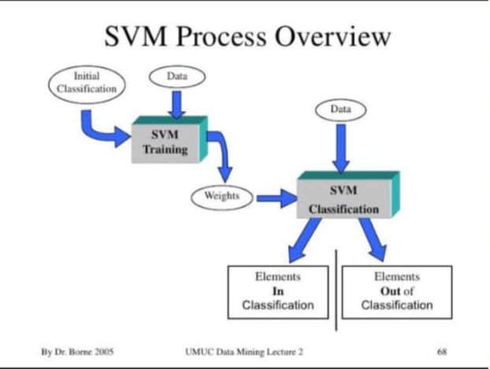
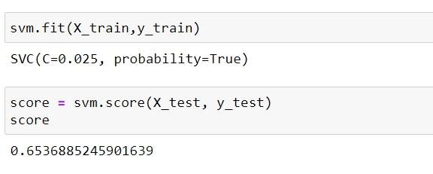
SVM
SVM is nothing but the Support Vector Machine
The SVM are supervised learning models with associated learning algorithms that analyze data for classification and regression analysis.
Accuracy:

Slide 14
Applications
Gets Sentiment analysis offers organizations the ability to monitor various social media sites in real time and act accordingly.
Stock picking and lead to superior returns.
Consumer voice,brand reputation,online commerce.
Politics application.

Slide 15
Output

Slide 16
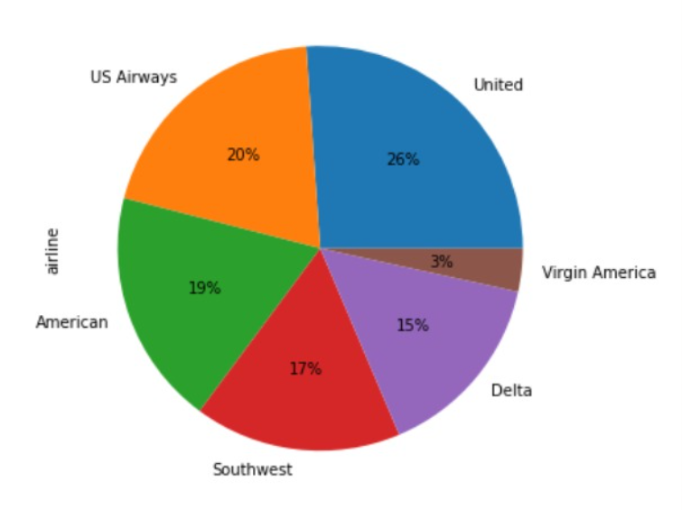
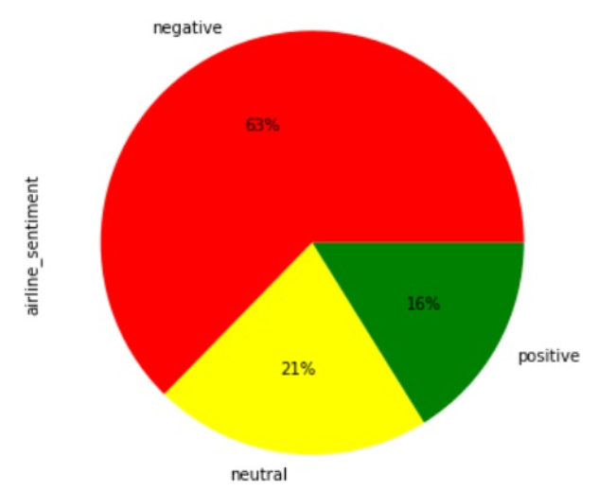

Slide 17
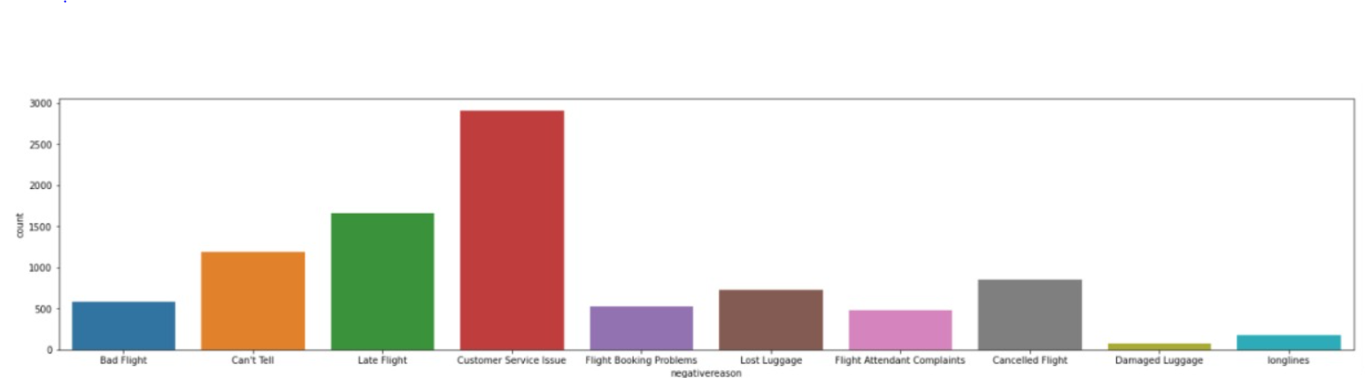

Slide 18
Algorithm Success Rate

Slide 19
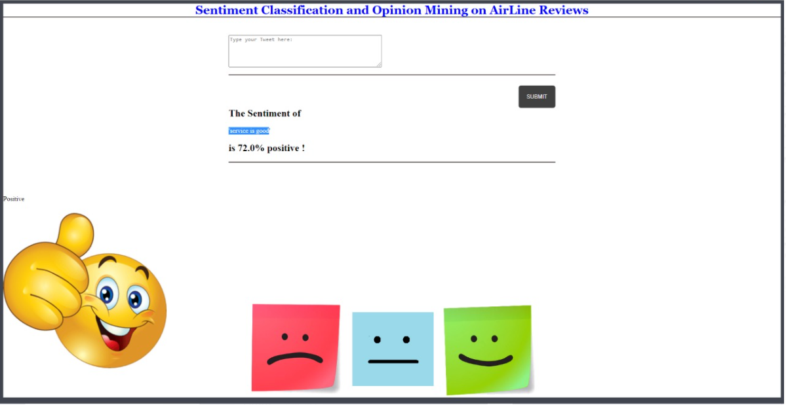
Positive

Slide 20
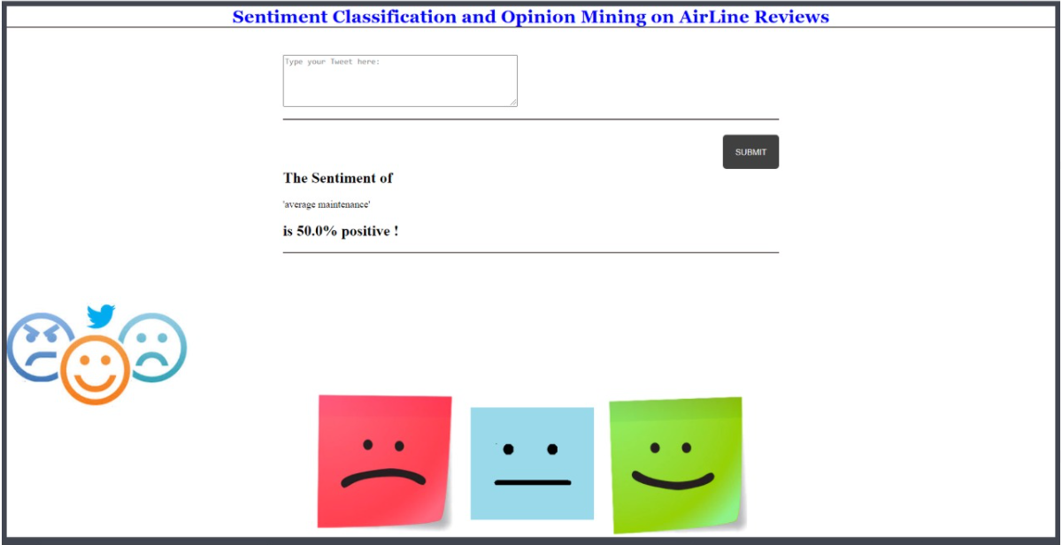
Neutral

Slide 21
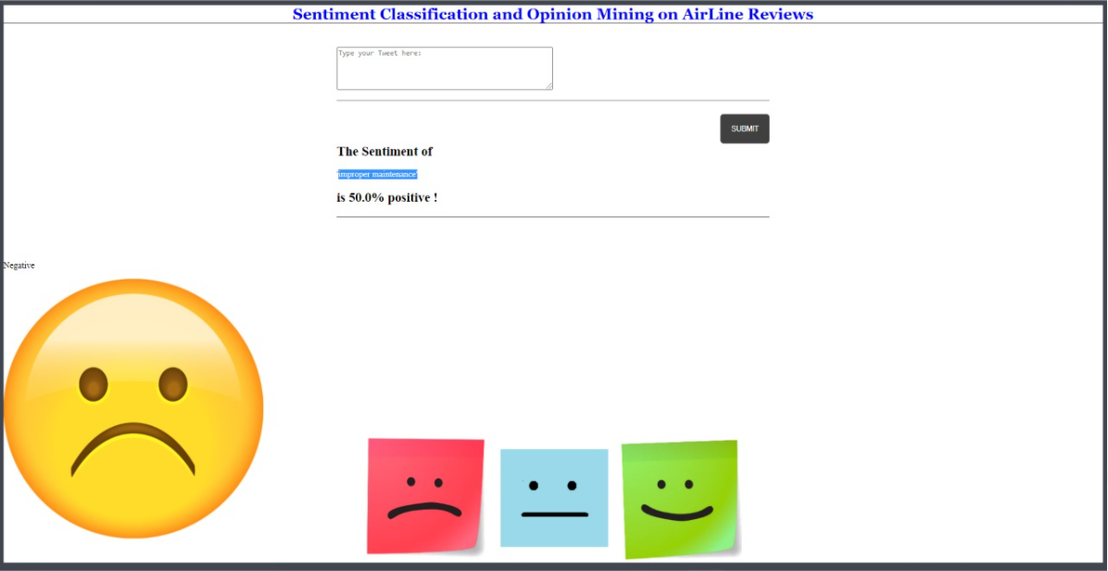
Negative

Slide 22
Conclusion
Sentiment analysis is a trend to understand the needs of the mass public.
We had considered the sentiment of the people towards the airlines industry and trackled the recent issues of Airlines and how the public feels about it.

Slide 23

Thank You

